Slide 1

Database
Lecturer: Dr. Bui Ha Duc
Dept. of Mechatronics
Email: ducbh@hcmute.edu.vn

Slide 2
Setting up LAMP Server
MySQL Install MySQL Server and Client:
sudo apt-get install mariadb-server mariadb-client
During installation, set up password for “root” user or change password later with
Secure MySQL Installation
sudo mysql_secure_installation
C library for MySQL:
sudo apt-get install libmariadb-dev
Python Library for MySQL:
pip3 install mysql-connector-python

Slide 3
Setting up MySQL
Create new account for MySQL
Login to MySQL as Root
sudo mysql -u root –p
Create a New User
create user ‘your_name’@’localhost’ identified by ‘your_password’;
Allow the new user full access to all databases:sql
grant all privileges on *.* to ‘your_name’@’localhost’ with grant option;
Apply Changes
flush privileges;

Slide 4
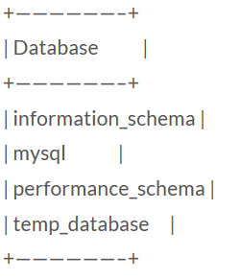
Create new database in MySQL
Open MySQL with:
sudo mysql –uroot –p
This command will logs into MySQL as the root user (-u) and it will prompt for a password (-p) on entry.
Create new database:
CREATE DATABASE temp_database;
List all databases:
SHOW DATABASES;

Slide 5
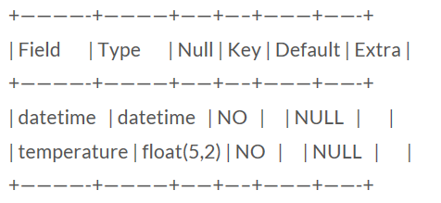
Create new database in MySQL
Select temp_database
USE temp_database;
Create a new table name “tempLog”
CREATE TABLE tempLog(datetime DATETIME NOT NULL, temperature FLOAT(5,2) NOT NULL);
Check new table
mysql> DESCRIBE tempLog;

Slide 6
MySQL data types
(Refer to https://www.tutorialspoint.com/mysql/mysql-data-types.htm and https://dev.mysql.com/doc/refman/8.0/en/data-type-overview.html for more detail)
Numeric types
INT: signed 32bit int, range from -2147483648 to 2147483647
TINYINT: signed 8bit INT
MEDIUMINT: signed 24bit INT
FLOAT(M,D): floating-point number with display length M and number of decimals D.
Date and Time types
DATE: a date in YYYY-MM-DD format
DATETIME: date and time combination in YYYY-MM-DD HH:MM:SS format.
TIME: store time in HH:MM:SS format

Slide 7
MySQL data types
String types
CHAR(M): fixed-length (M) string, max 255 characters
VARCHAR(M): variable-length string, max 255 characters
BLOB or TEXT: a field with maximum 65535 characters

Slide 8
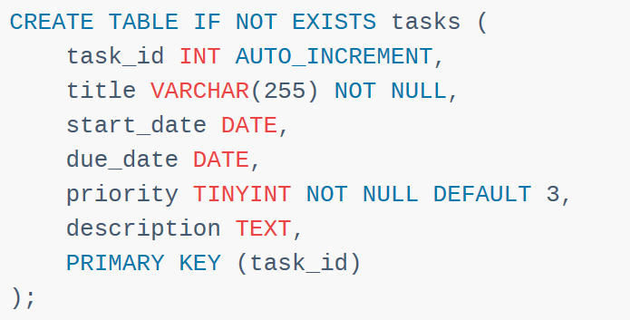
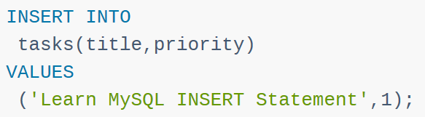
Examples

Slide 9
MySQL Data manipulation
Insert data to a table
Insert a single row
INSERT INTO table_name(c1,c2,...) VALUES (v1,v2,...);
Insert multiple rows:
INSERT INTO table_name(c1,c2,...) VALUES (v11,v12,...),(v21,v22,...), ..., (vnn,vn2,...);
Delete data from a table
Delete rows:
DELETE FROM table_name WHERE condition;
e.g. DELETE FROM temperature WHERE ID = 4;
DELETE FROM temperature WHERE ID < 4;
DELETE FROM diemdanh WHERE name = ‘Hieu’;

Slide 10
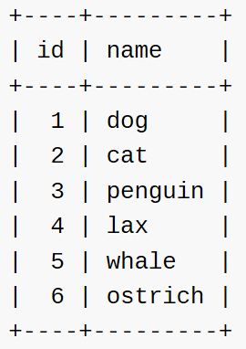
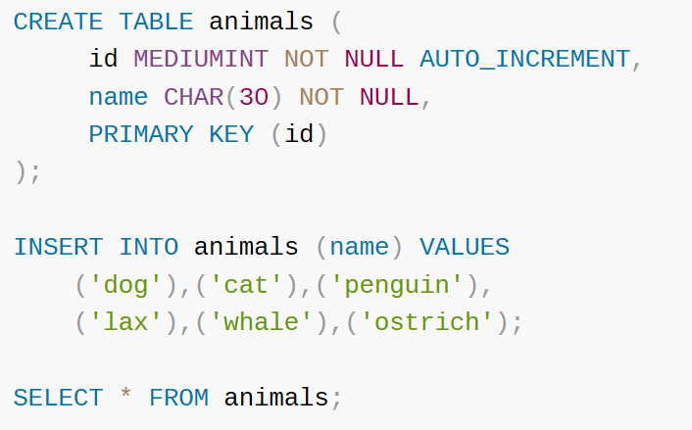
Example
https://dev.mysql.com/doc/refman/8.0/en/example-auto-increment.html

Slide 11
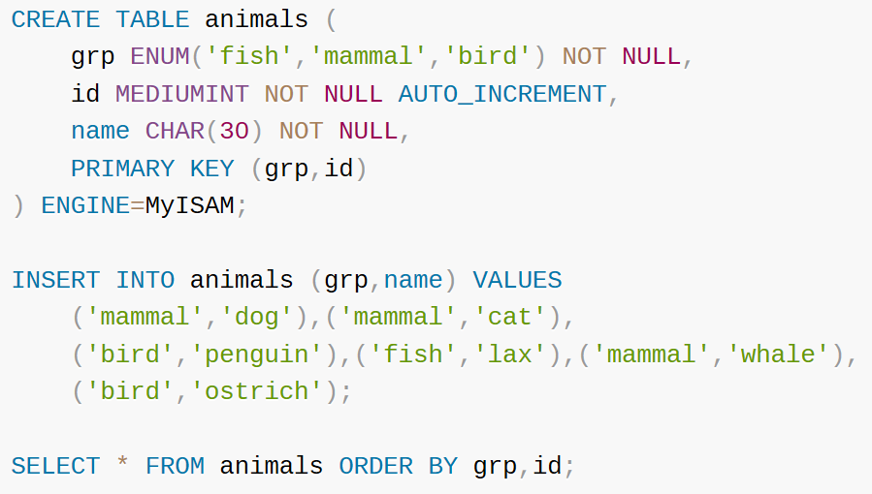
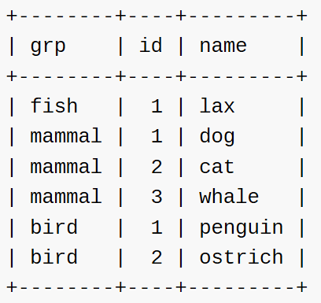
Example

Slide 12
MySQL Data manipulation
Update data in a table:
Update a row:
UPDATE table_name
SET
column_name1 = expr1,
column_name2 = expr2,
...
[WHERE
condition];
e.g. UPDATE sensor SET temp = 30, humid = 65 WHERE id = 1;
UPDATE table1 SET col1 = col1 + 1, col2 = col1;

Slide 13
MySQL Data manipulation
Select data from a table
Select clause:
SELECT
column_1, column_2, ...
FROM
table_1
WHERE
conditions
ORDER BY column_1
LIMIT offset, length;
e.g. SELECT ho, ten, mssv FROM danhsach;
SELECT temp FROM sensor LIMIT 50,20

Slide 14
Send data to database in C
#include <mysql.h>
#include <stdio.h>
float data; // data you want to send to database
int main(void) {
MYSQL *conn;
MYSQL_RES *res;
MYSQL_ROW row;
char *server = "localhost";
char *user = "root";
char *password = "PASSWORD"; /* set me first */
char *database = "temp_database";
while(1){
// Connect to database
conn = mysql_init(NULL);
mysql_real_connect(conn,server,user,password,database,0,NULL,0);
Notes:
http://www.raspberry-projects.com/pi/programming-in-c/databases-programming-in-c/mysql/accessing-the-database

Slide 15
Send data to database in C
// Create sql command
char cmd[200];
sprintf(cmd,"insert into gyro(Gx) values (%.2f)",data);
// send SQL query
mysql_query(conn, cmd);
mysql_close(conn);
}
return 0;
}
Notes:
http://www.raspberry-projects.com/pi/programming-in-c/databases-programming-in-c/mysql/accessing-the-database

Slide 16
Send data to database in C
Compile the program with:
$ gcc -o output_file $(mariadb_config --cflags) source_code.c $(mariadb_config --libs)

Slide 17
Retrieving data from the DB in C
In C (refer to this link for more detail http://zetcode.com/db/mysqlc/ )
Step 1: select data
mysql_query(con, "SELECT * FROM sensor")
Step 2: save data into a variable
MYSQL_RES *result = mysql_store_result(con);
Step 3: get number of columns
int num_fields = mysql_num_fields(result);
Step 4: retrieve each row data
MYSQL_ROW row;
while ((row = mysql_fetch_row(result)))
{
for(int i = 0; i < num_fields; i++)
{
// your code
}
}

Slide 18
Retrieving data from the DB in C
#include <mysql.h>
#include <stdio.h>
int main(void) {
MYSQL *conn;
MYSQL_RES *res; // variable used to store DB data
MYSQL_ROW row;
char *server = "localhost";
char *user = "root";
char *password = "PASSWORD"; /* set me first */
char *database = "temp_database";
while(1){
// Connect to database
conn = mysql_init(NULL);
mysql_real_connect(conn,server,user,password,database,0,NULL,0);

Slide 19
Retrieving data from the DB in C
// Read data from database
mysql_query(conn, "select * from data_table");
res = mysql_store_result(conn);
int num_column = mysql_num_fields(res);
while (row = mysql_fetch_row(res))
{
printf("%s \t %s \t %d \n",row[0], row[1],row[2]);
}
// clear result and close the connection
mysql_free_result(res);
mysql_close(conn);
}
return 0;
}

Slide 20
Connecting to SQL using Python
import mysql.connector
conn = mysql.connector.connect(
host="localhost",
user="your_user",
password="your_pass",
database="Temp_db"
)
cursor = conn.cursor()
sql = "insert into sensors(temp,humid) values (32,76)"
cursor.execute(sql)
conn.commit()
cursor.execute("SELECT * FROM sensors")
result = cursor.fetchall() # fetchone() to read 1 row
for x in result:
print(x)

